Slide 1
Desafíos del DBA SQL Server en la nueva era
Speaker
Maximiliano Accotto | owner TriggerDB Consulting SRL

Slide 2
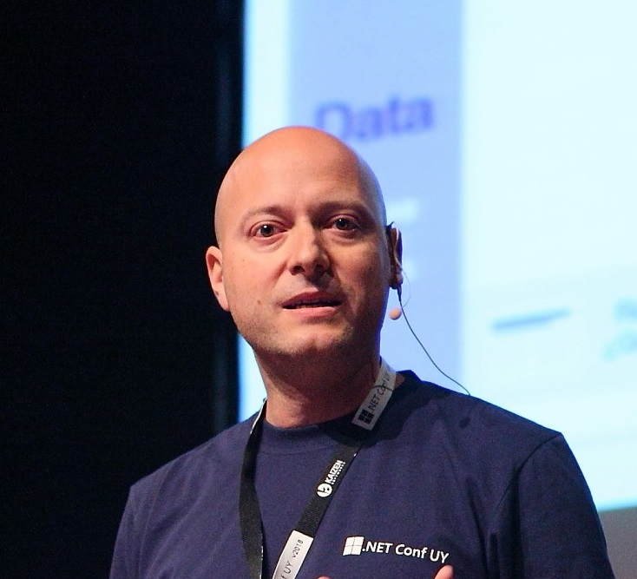




Acerca de mi
Argentino nacido en Adrogue Provincia de Buenos Aires
Data platform Geek
Microsoft MVP Data Platform desde el 2005.
Speaker internacional con mas de 500 charlas impartidas
Especialista en tecnologías de Data y BI con mas de 15 años de trayectoria
https://twitter.com/maxiaccotto
https://ar.linkedin.com/in/maxiaccotto
maxi@triggerdb.com

Slide 3


Sobre TriggerDB
TriggerDB Consulting SRL es una empresa Argentina fundada por Maximiliano Accotto , experto reconocido a nivel mundial en Microsoft SQL Server y BI. Somos partner certificados de Microsoft en las competencias de SQL Server, Data Analytics y Powerbi. Nuestros mas de 15 años de trayectoria , alto expertice y mas de 150 clientes en toda la región, nos hace lideres en servicios de consultoría y capacitación en tecnologías de SQL Server , analytics y Powerbi.

Slide 4

El desafio del DBA en la actualidad

Slide 5
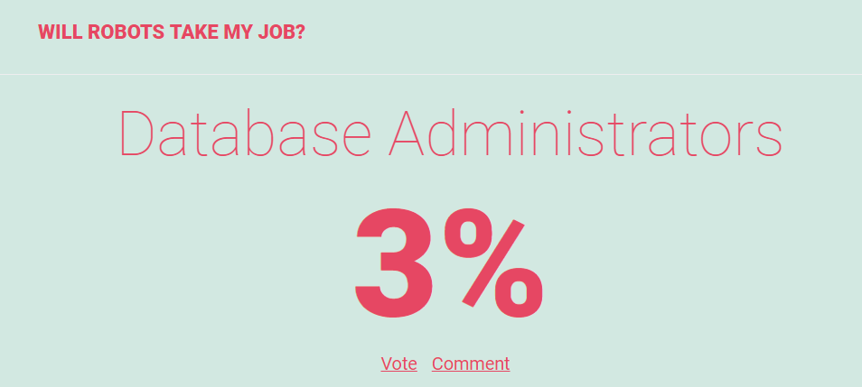
¿Que puede pasar con nuestro role?
https://willrobotstakemyjob.com/

Slide 6
La evolución

Slide 7

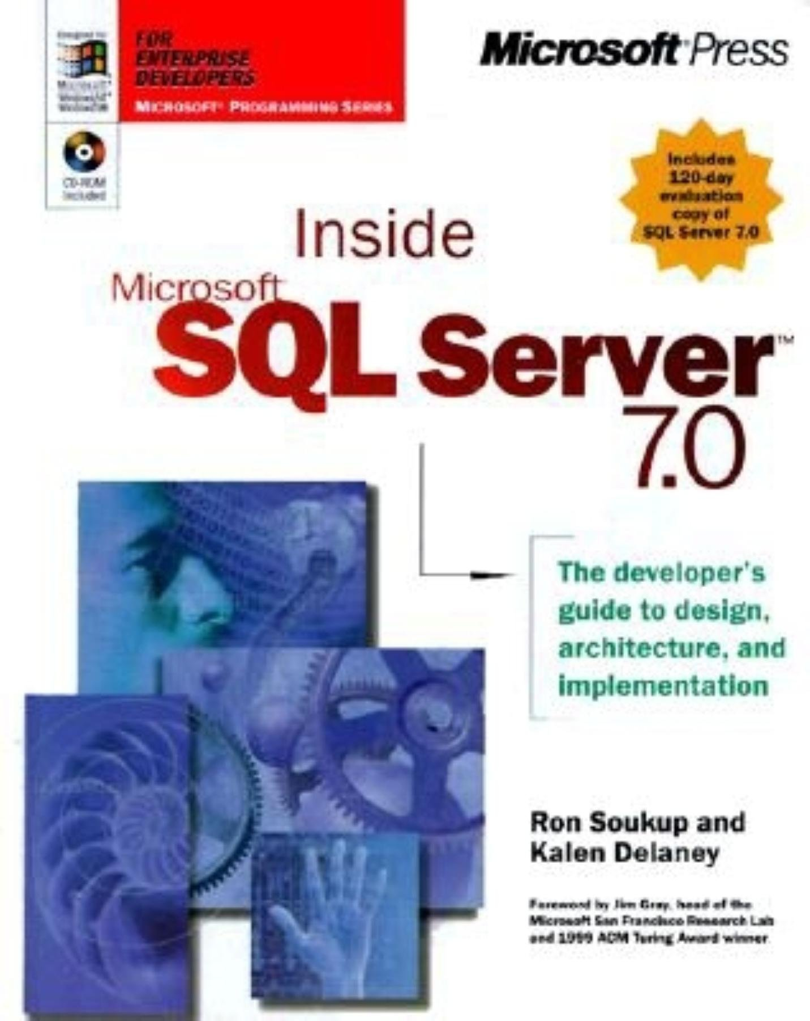
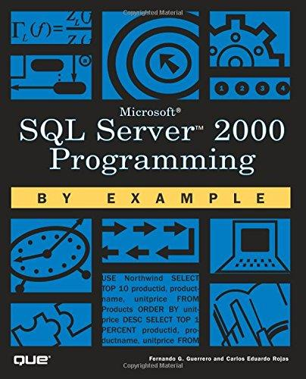


Mi evolución aprendiendo como DBA
Mi actualidad
Mis inicios

Slide 8
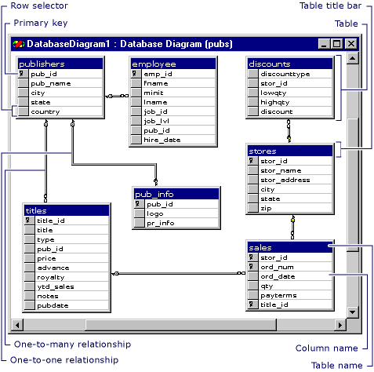
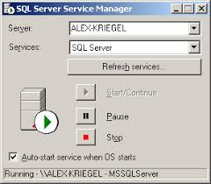
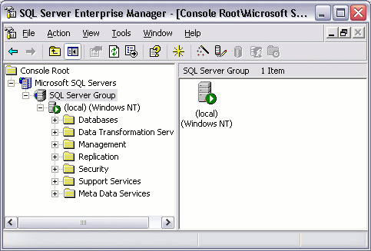
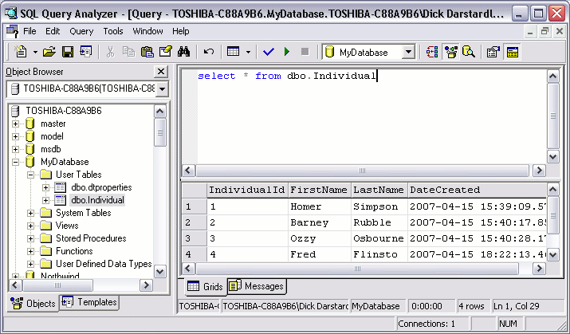
Tools que usaba

Slide 9
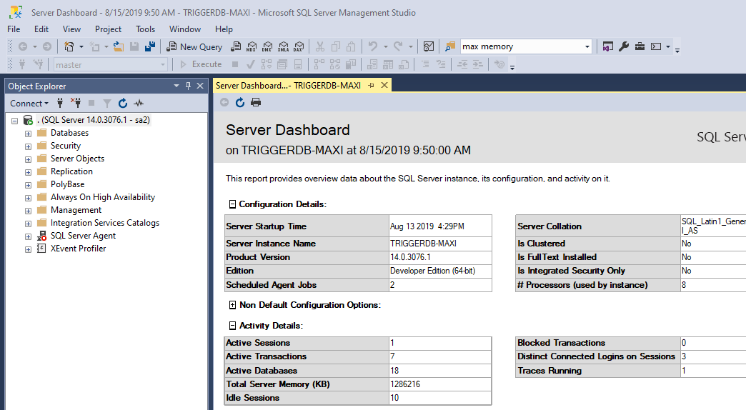
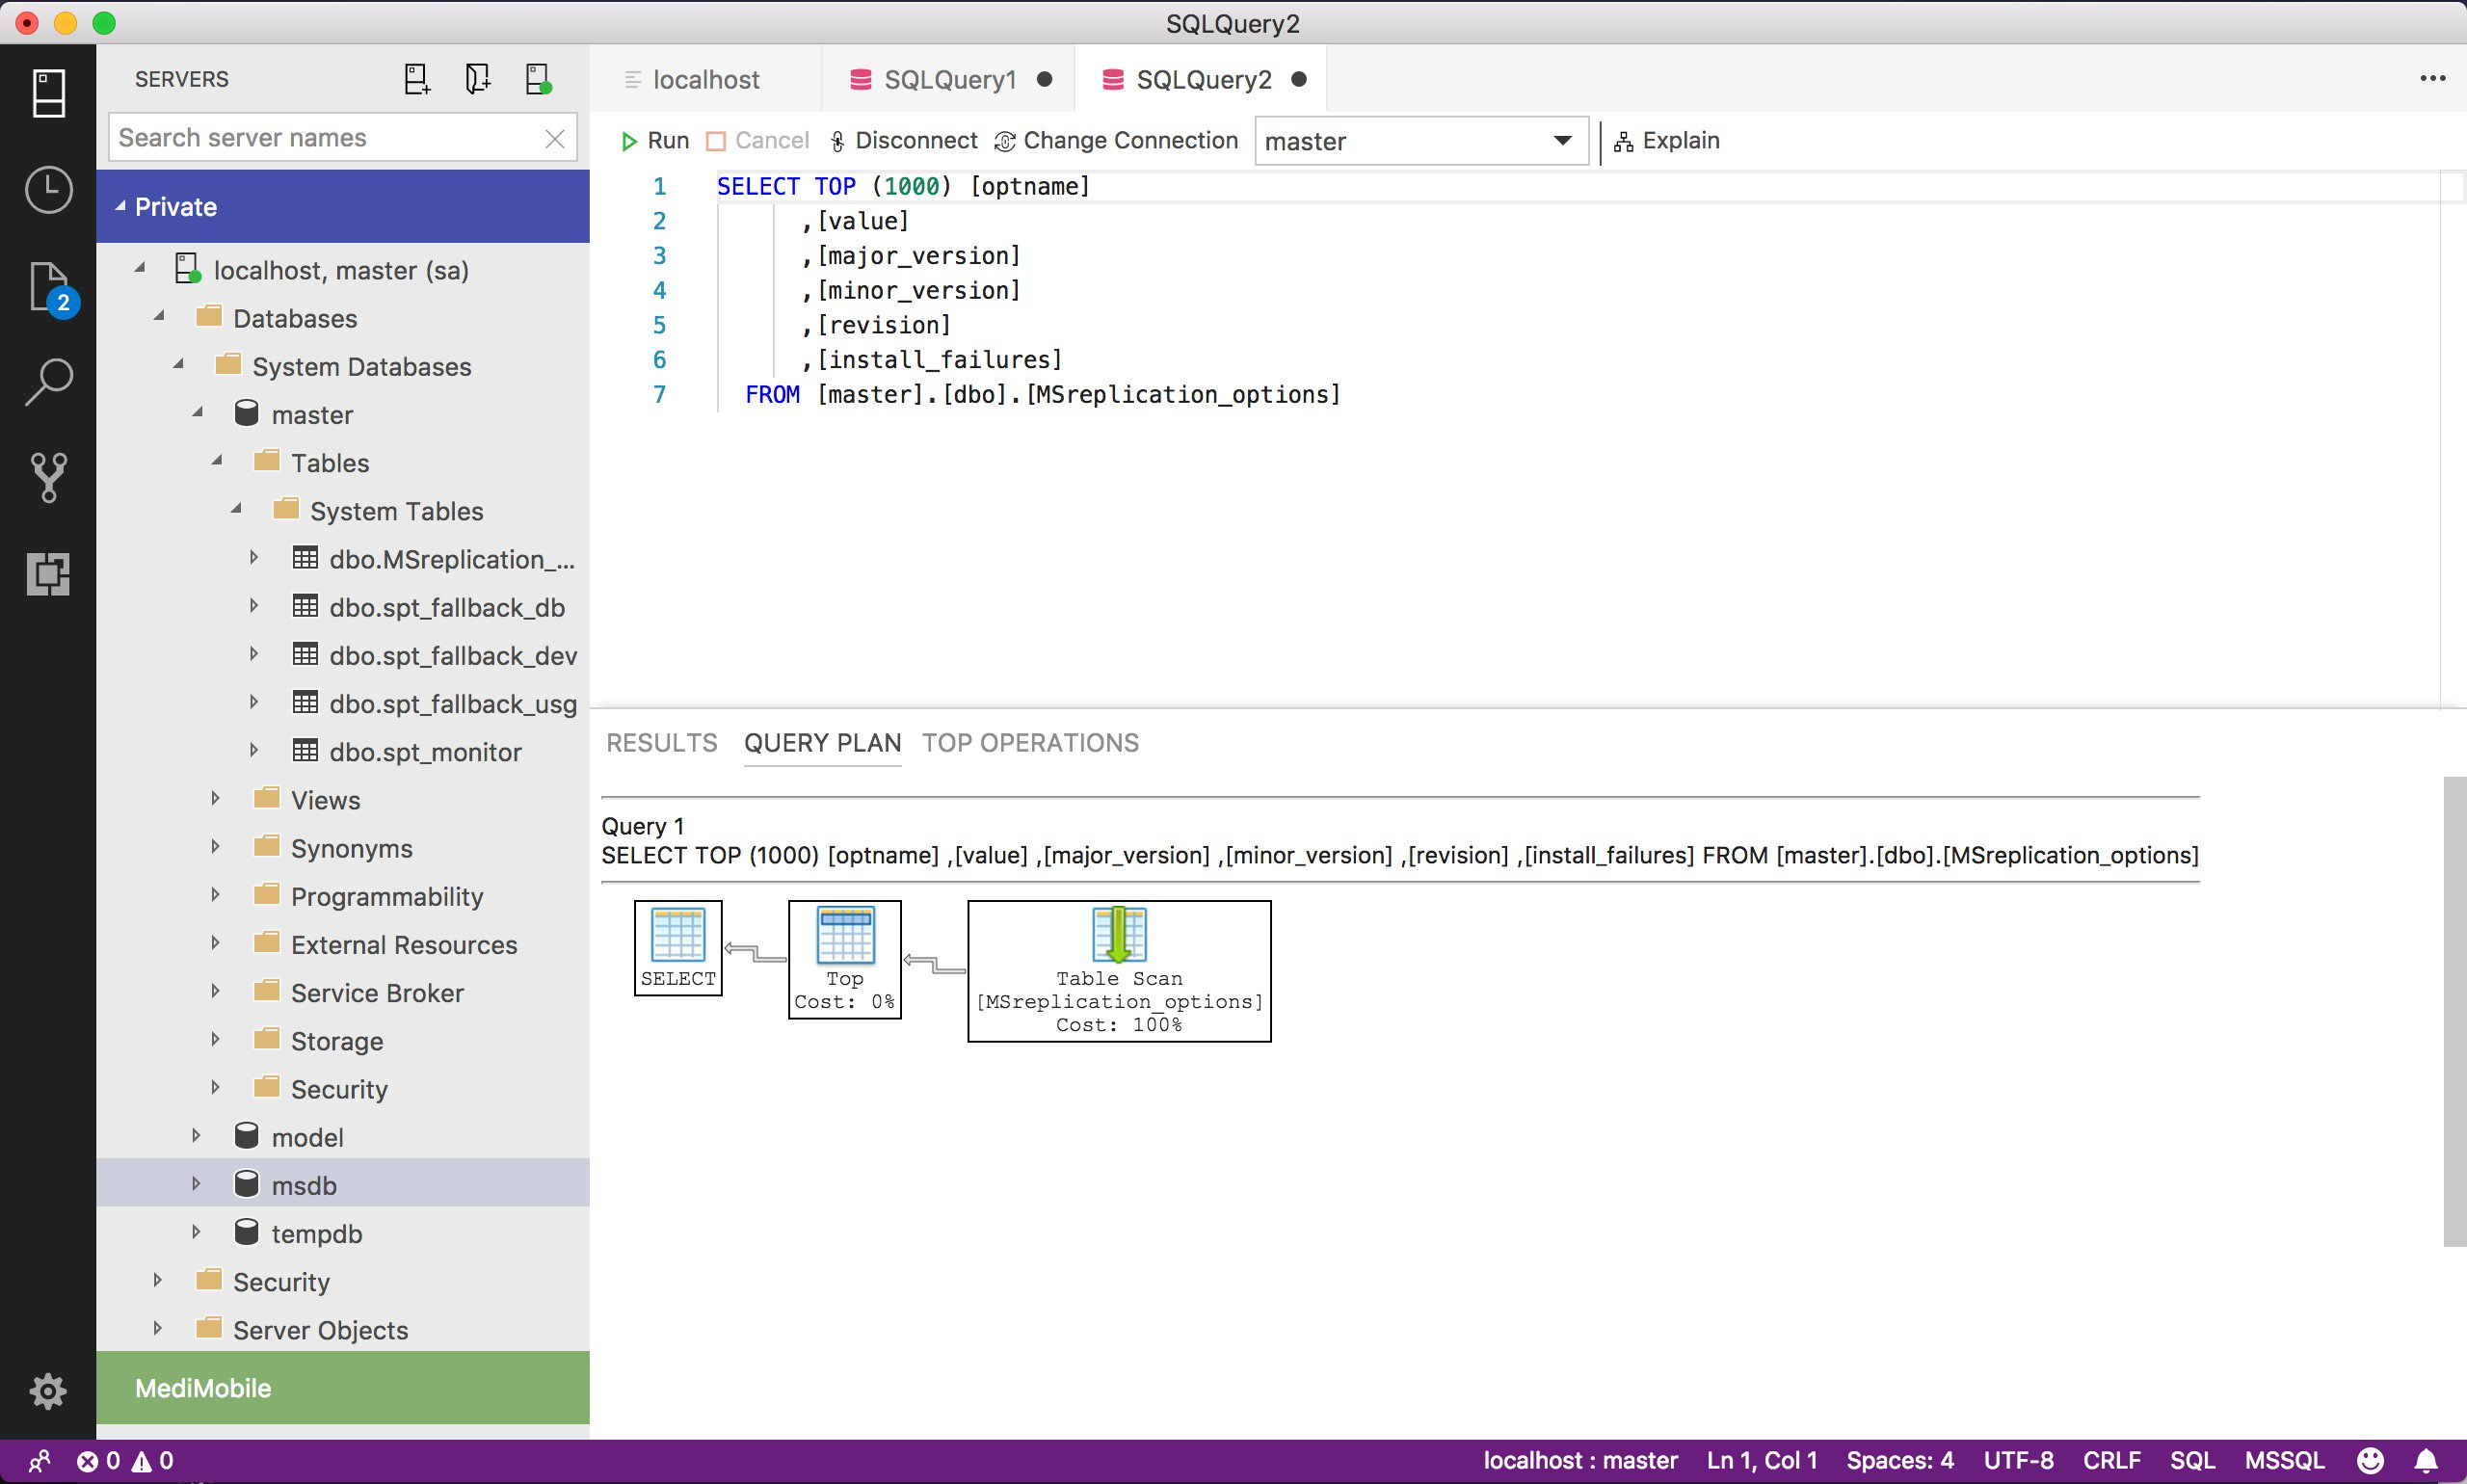
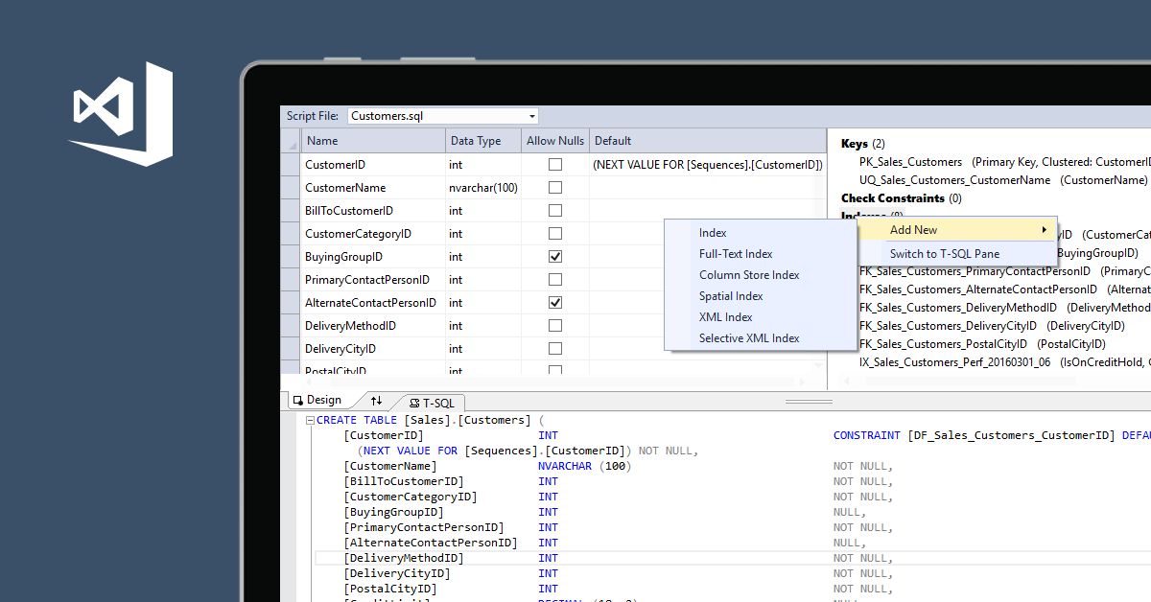
Tools que uso hoy

Slide 10



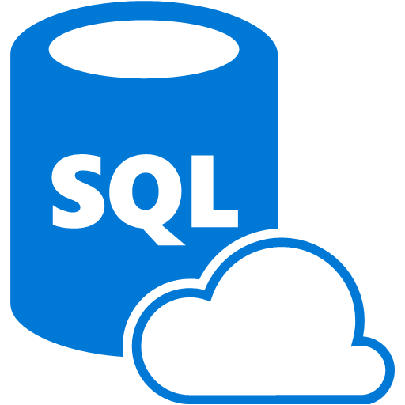
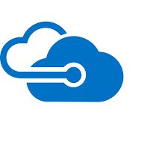

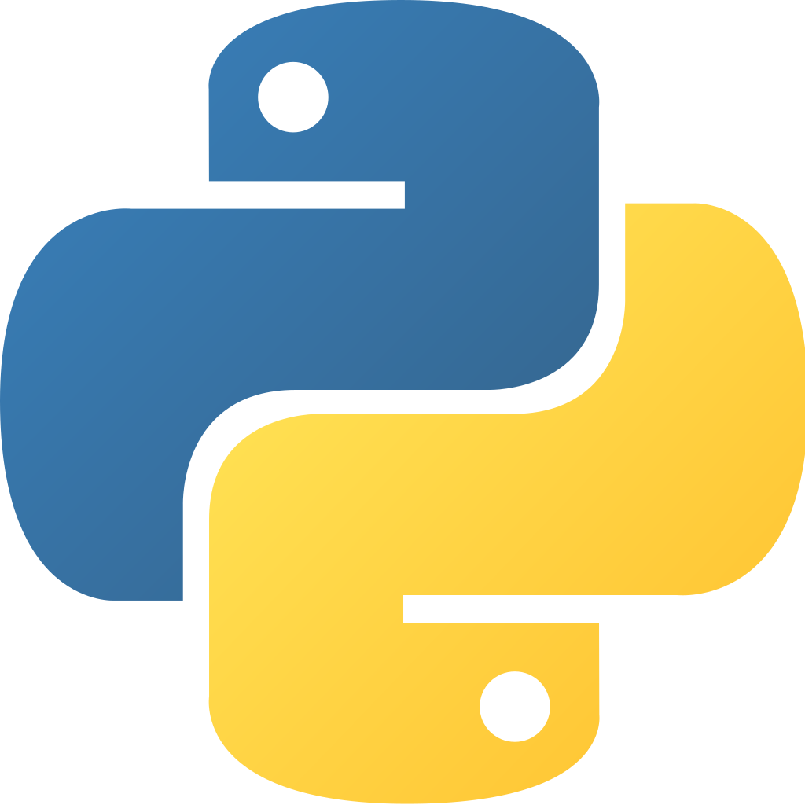

La actualidad del DBA SQL Server

Slide 11
Evolución de SQL Server en el tiempo
SQL 1.1 - 1991
SQL 7.0 – 1998
SQL 2000
XML
SQL 2016/ 2017 y futuro
SQL 6.5 - 1996
SQL 4.2 - 1993
Windows 3.0
OS/2
Windows NT
OS/2
Ansi Compliant
OLAP Database
SQL 2005
CLR
SQL 2008
Service Broker
SODA
Spatial DB
Jerarquicos Data Type
Data Mining
SSIS
SSRS
SQL 2012
In-memory Index
DQS
MDS
SQL 2014
InMemory OLTP
Cloud
Linux
Docker
Kubertentes
Big Data
Machine Learning
Polybase
HDFS
Data Lake
FileStream
CEP
FileTable

Slide 12
SQL y Cloud

Slide 13

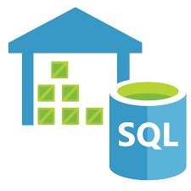
SQL Server y “Cloud”
Cloud Privada
Cloud Publica
Cloud hibrida
SQL Server in
Virtual Machine (IAAS)
SQL
Azure SQL Database
Azure SQL Database Managed Instance
(PAAS)
Azure SQL Data
Warehouse

Slide 14
MSSQL y Linux

Slide 15
SQL Server y Linux
Linux
SQL 2017 o sup
Support for RedHat Enterprise Linux (RHEL), Ubuntu, and SUSE Enterprise Linux (SLES)
Package-based installation: Yum Install, Apt-Get, and Zypper
Database Compatibility on all Platforms

Slide 16
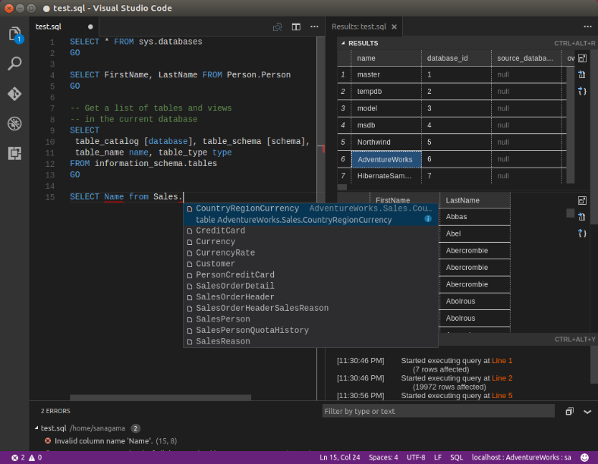
SQL Server y Linux – Admin tools
Windows SQL Server Management Studio (SSMS)
Windows SQL Server Data Tools (SSDT)
3rd party tools continue to work
Existing drivers/frameworks supported
Azure Data Studio
Visual Studio Code mssql extension
Native OS command line tools
sqlcmd, bcp, sqlpackage
mssql-cli
mssql-scripter

Slide 17
MSSQL y Containers

Slide 18

Why Containers?
Portable
Run anywhere Docker is supported
Lightweight
Reduced disk, CPU, and memory footprint
Consistent
Consistent image of SQL Server, scripts, and tools
Efficient
Faster deployment, reduced patching, and less downtime
Container configuration
Persisted storage
Database
Switch for
simple upgrades
Container
Container
Container
sqlservr
sqlservr
sqlservr
Bins/libs
Bins/libs
Bins/libs
Docker
Host OS
Infrastructure

Slide 19
k8s implementations
minikube
Kubeadm
RedHat OpenShift
Azure Kubernetes Service (AKS)
OpenShift on Azure (OSA)
Single node on your laptop
Install your own cluster
K8s platform private or public cloud
Azure hosted k8s
Managed OpenShift on Azure
Other
Azure Stack
Windows Server

Slide 20
Always On Availability Groups on Kubernetes
Availability groups on Kubernetes
Kubernetes cluster
Node
Pod
Load balancer
Operator
Reporting app
SQL Server/k8s failover integration
Operator deployment
AG concepts all apply
Load Balancer for Primary App
Load Balancer for Secondary Replica Readers
Node
Node
Node
Pod
Pod
Pod
AG
SQL Server primary
SQL Server primary
SQL Server secondary
SQL Server secondary
SQL Server secondary
AG agent
AG agent
AG agent
Load balancer
Primary app
Notes:
Presenter: Vin

Slide 21
MSSQL y ML

Slide 22


Llevar la inteligencia a donde están los datos
Application
Application + Intelligence
VS
Database
Intelligence + Database
Regular Database + App
Intelligence Database + App

Slide 23
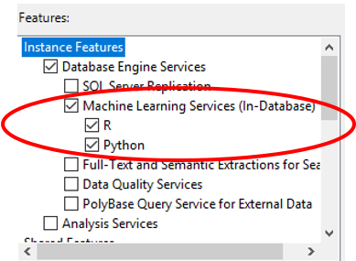
SQL Machine Learning Services
SQL Server 2016
R support (3.2.2 version)
Microsoft R Server
SQL Server 2017
Scoring native en TSQL usando PREDICT function
EXTERNAL LIBRARY DDL para el manejo de paquetes R
Ejecución en batch para la entrada de datos
Soporte para R (3.3.3 version)
Soporte para Python (Anaconda 3.5.2)
SQL Server 2019
Soporte para Java
Big Data Cluster

Slide 24
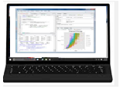
Data Scientists - Exploración de Datos y Desarrollo de Modelos
train <- RxSqlServerData(query, connectionString, computeContext)
rxLogit(formula, train)
2
Execution
1
Script
Data Scientist Workstation
SQL Server
3
Results
Machine Learning Services
Any R/Python IDE
R/Python Runtime

Slide 25
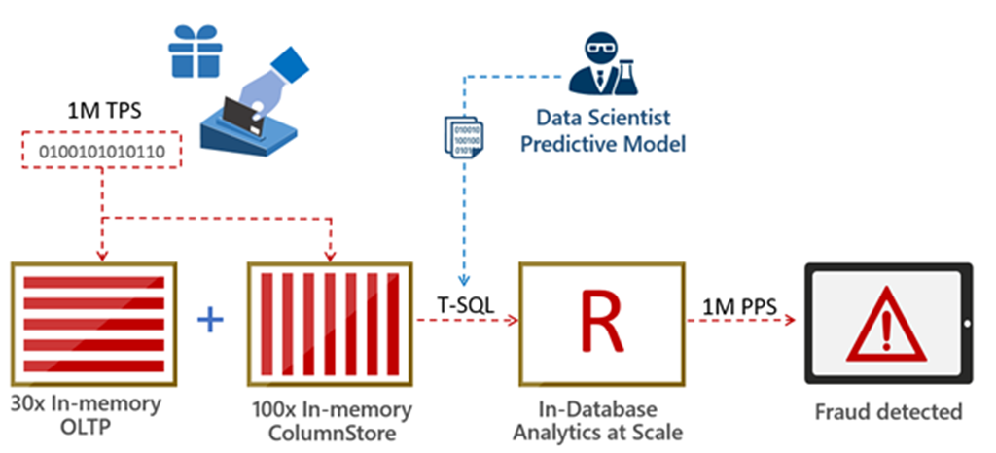
1,000,000 predictions per second
https://blogs.technet.microsoft.com/dataplatforminsider/2016/10/11/1000000-predictions-per-second/

Slide 26
MSSQL Data Virtualization

Slide 27
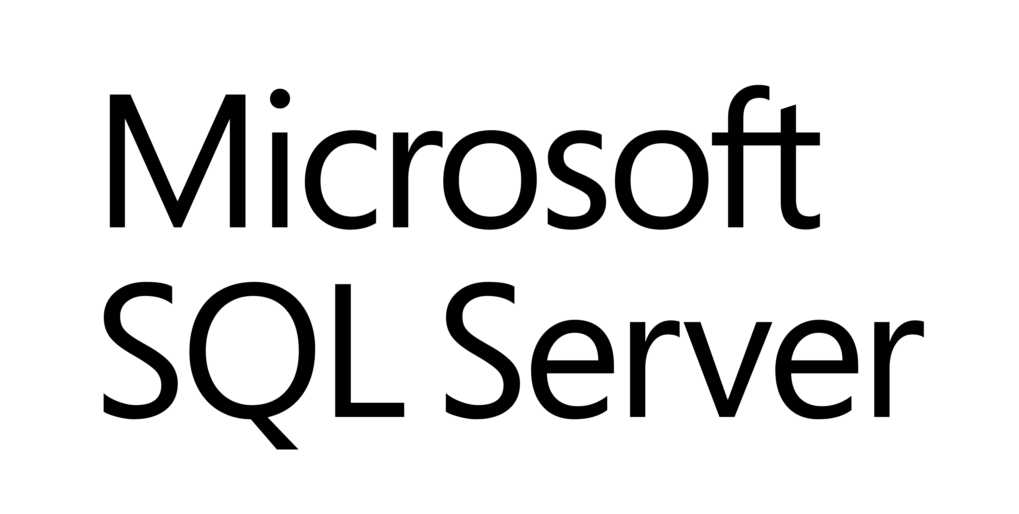





SQL Server 2019: Data Virtualization
Modern StockItems
Legacy Suppliers
Mobile
App Orders
WWI
SQL Server
2019
SQL
WideWorldimporters
Customers from Acquisition
Order Reviews
Accounts Receivable
Notes:
This is a great example for a company that has existing data sources but doesn’t want to or cannot move the data. This diagram can be demonstrated with a demo video or using the github examples at https://github.com/microsoft/sqlworkshops/tree/master/ModernizeYourDatabases2019/ModernizeSQL2019/Module%208%20Activity%20-%20Data%20Virtualization

Slide 28
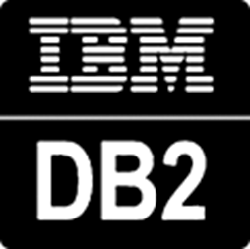

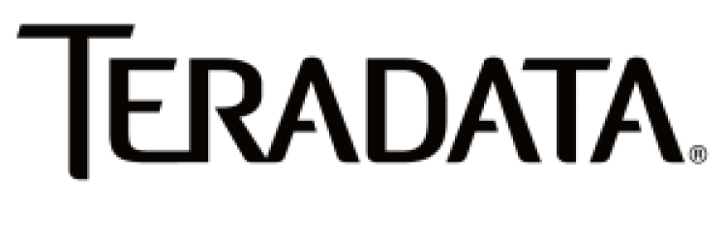




SQL Server Polybase?
Distributed compute engine integrated with SQL Server
Query data where it lives using T-SQL
Distributed, scalable query performance
Manual/deploy with SQL Server
Auto deploy/optimize with Big Data Clusters
Analytics
T-SQL
Apps
SQL Server
PolyBase external tables
ODBC
NoSQL
Relational databases
Big data
Excel
Cosmos DB
HDFS
Notes:
Polybase came in SQL 2016 but we now have expanded the number of data sources
For NoSQL, Relational, and Hadoop, all client software built-in. ODBC is “bring your own driver” but opens up the possibilities
Note as of CTP 2.5, Polybase for Linux only supports NoSQL and Relational databases

Slide 29
SQL Server 2019 Big Data Clusters
Data virtualization
Managed SQL Server, Spark, and data lake
Complete AI platform
Admin portal and management services
Integrated AD-based security
Analytics
T-SQL
Apps
REST API containers for models
SQL Server External Tables
SQL Server
Spark
SQL Server
ML Services
Spark & Spark ML
Compute pools and data pools
Scalable, shared storage (HDFS)
Open database connectivity
NoSQL
Relational databases
HDFS
External data sources
HDFS
Combine data from many sources without moving or replicating it
Scale out compute and caching to boost performance
Store high volume data in a data lake and access it easily using either SQL or Spark
Management services, admin portal, and integrated security make it all easy to manage
Easily feed integrated data from many sources to your model training
Ingest and prep data and then train, store, and operationalize your models all in one system
Notes:
BDC is all about providing the install and configuration of Polybase automatically but if you don’t have Hadoop we will install one for you and include Spark with it. The right side of the slide is about using BDC as a complete ML/AI platform. All of this deployed on a cluster that is secure and provides built-in management, HA, and scale using Kubernetes.
Note: As of CTP 2.5, BDC does not support ODBC drivers for Polybase

Slide 30
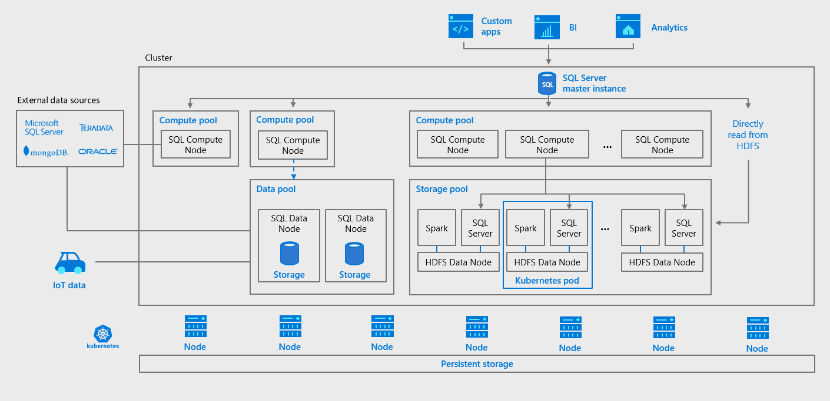
SQL Server 2019 y ML (big data Cluster)

Slide 31
Links
MS Build 2019
https://www.microsoft.com/en-us/build
SQL Server 2019 big data cluster
https://docs.microsoft.com/en-us/sql/big-data-cluster/big-data-cluster-overview?view=sqlallproducts-allversions
SQL Server containers
https://docs.microsoft.com/en-us/sql/linux/quickstart-install-connect-docker?view=sql-server-2017&pivots=cs1-bash

Slide 32
Muchas gracias

